Slide 1
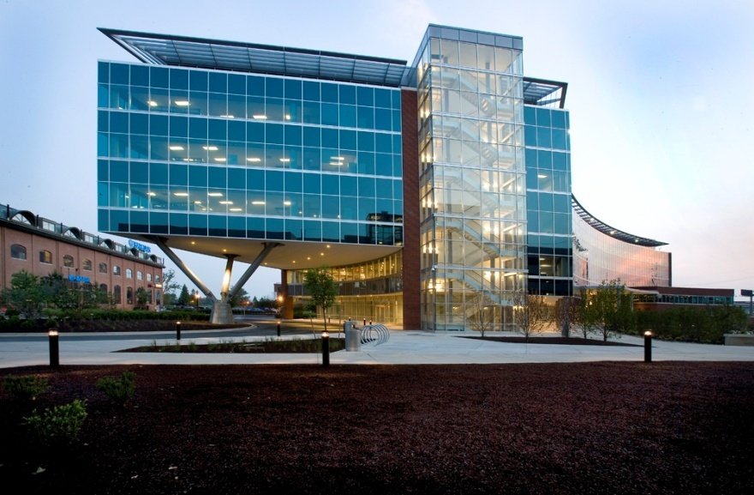
ONE CHRISTINA CRESCENT
Wilmington, Delaware
Lighting System Conceptual Design
Kevin Michael Danna
Penn State Architectural Engineering Senior Thesis

Slide 2
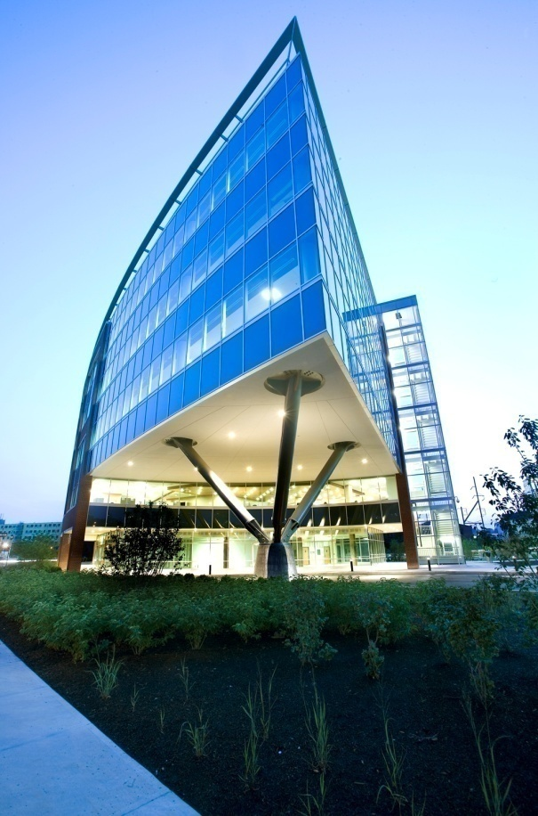
ONE CHRISTINA CRESCENT Wilmington, Delaware Lighting System Conceptual Design
BUILDING OVERVIEW
One Christina Crescent is a six story office building located in Wilmington, Delaware and is home to Barclays Bank Delaware, the U.S. credit card operations of Barclays PLC. The building was constructed by Pettinaro Construction Company, Inc. of Newport, DE and is owned by Christina Crescent LLC.
Building Name: One Christina Crescent
Building Location: 125 S. West Street, Wilmington, Delaware
Building Occupant: Barclays Bank Delaware
Occupancy Type: Corporate Offices/Retail
Size: 279,376 SF
Height: 6 stories, 88'-0" above grade
Dates of Construction: Winter 2006 to Summer 2007
Cost: $40 million
Project Delivery Method: Design-Build

Slide 3
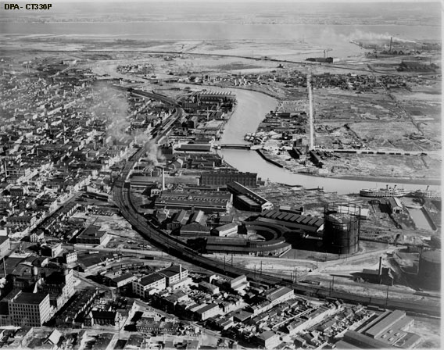
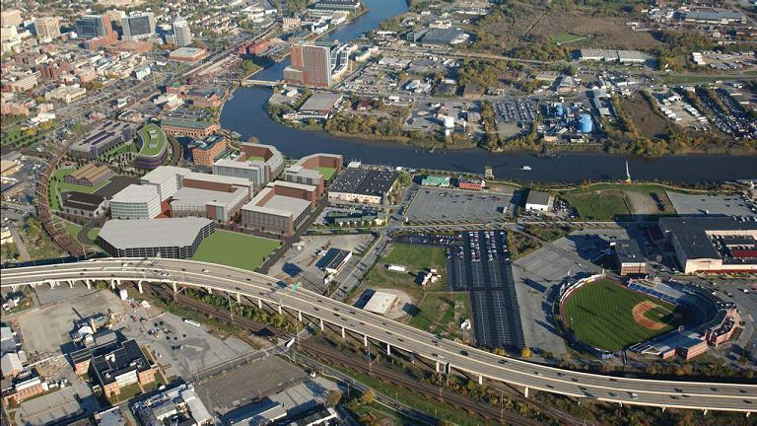
ONE CHRISTINA CRESCENT Wilmington, Delaware Lighting System Conceptual Design
RIVERFRONT WILMINGTON
One Christina Crescent is located in an area of Wilmington known as ‘Riverfront Wilmington’ which is on the banks of the Christina River. The building’s site is redeveloped brown field which was multi-parcel industrial wasteland. Decades ago, the area was a thriving industrial center, but was left abandoned for many years. Since the mid 1990s, the Riverfront Development Corporation of Delaware (RDC) has been revitalizing the area.
Wilmington Riverfront (1950s)
Wilmington Riverfront (Present Day)

Slide 4
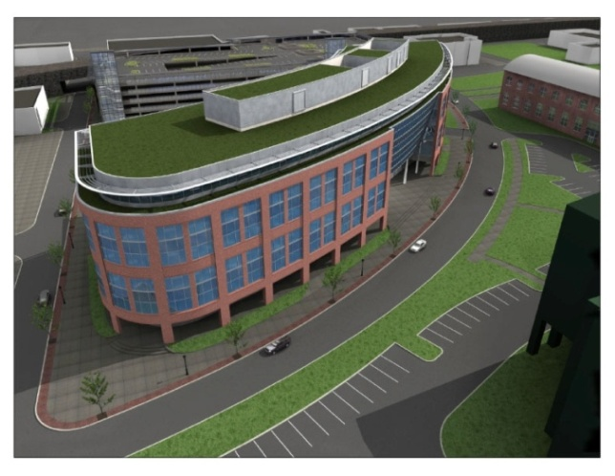
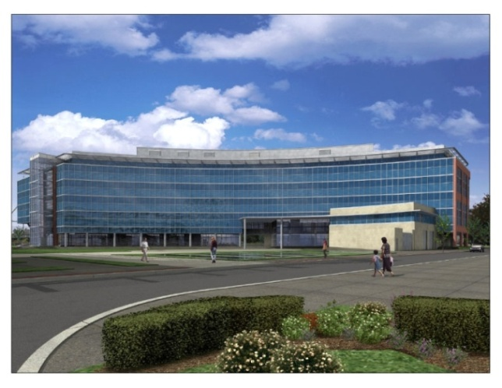
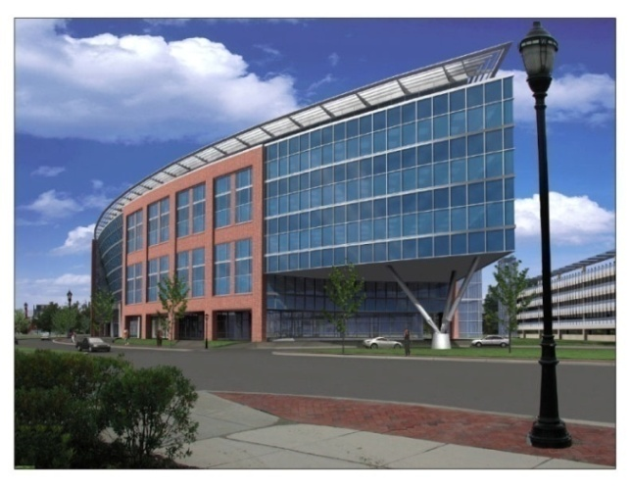
ONE CHRISTINA CRESCENT Wilmington, Delaware Lighting System Conceptual Design
BUILDING DESIGN
Design Architect: Paul Guggenberger, AIA, Moeckel Carbonell Associates, Inc. Architect of Record: Mark G. Hitchcock, AIA Interior Design: Mitchell Associates Structural Engineer: O'Donnell Naccarato Macintosh Civil Engineer: Rummel, Klepper, Kahl LLP Environmental Engineer: Brightfields Inc. Geotechnical Engineer: Duffields Associates, Inc.
There were aspirations during design for the building to be LEED certified. This was never realized, but aspects were retained. The green roof is the most prominent feature of the building originally part of the LEED design.

Slide 5
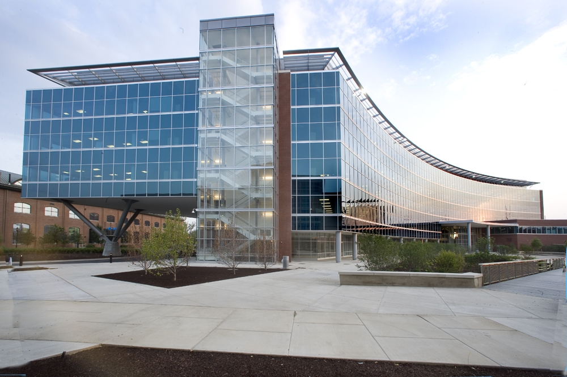
ONE CHRISTINA CRESCENT Wilmington, Delaware Lighting System Conceptual Design
THESIS CONCEPTUAL DESIGN
AREAS TO BE REDESIGNED
Open Office
Auditorium
Lobby
Dining Area
Tripod (Outdoor)
OVERALL DESIGN GOALS
Maximize energy efficiency
Minimize environmental impact
Reinforce a positive image of Barclays Bank
Delaware
Attention to employee well-being and office
productivity

Slide 6
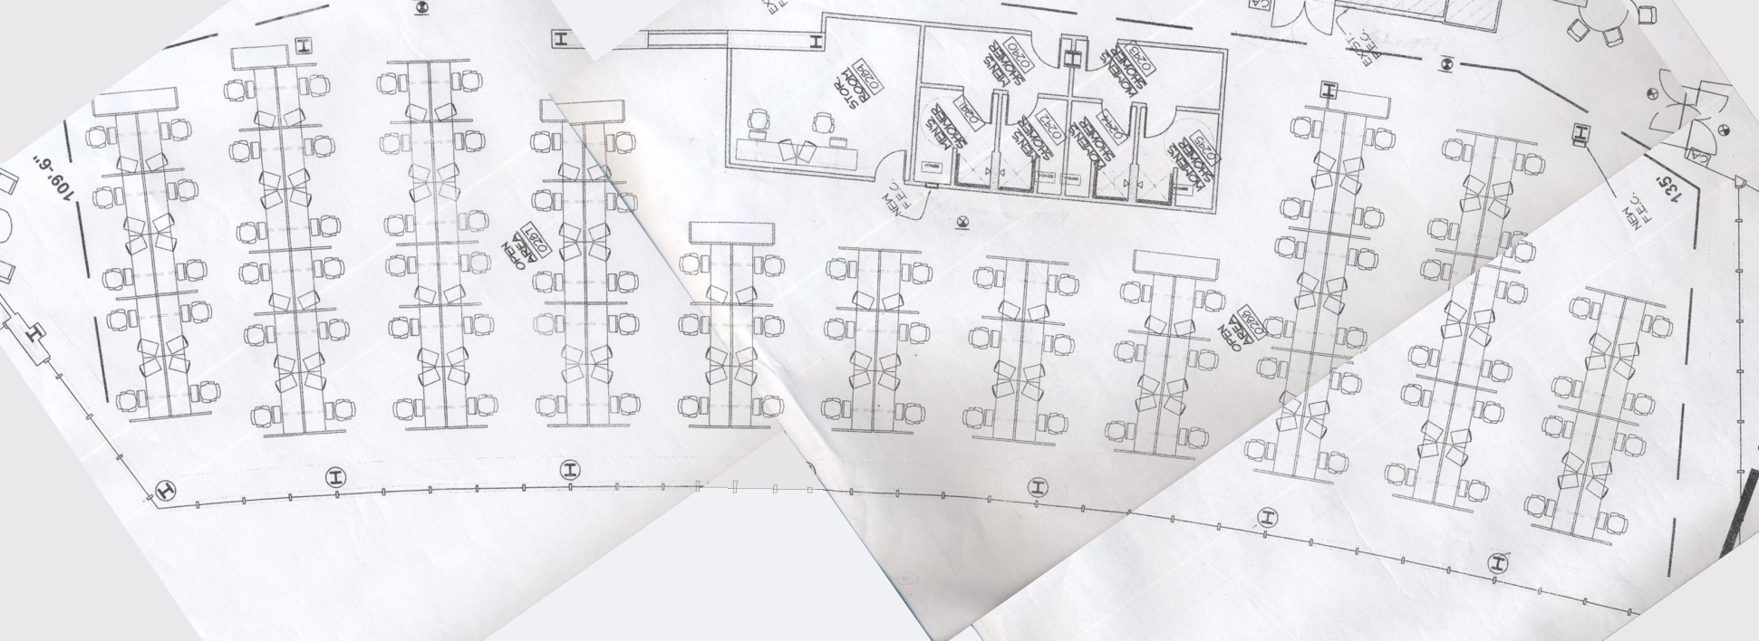
ONE CHRISTINA CRESCENT Wilmington, Delaware Lighting System Conceptual Design
OPEN OFFICE
SECOND FLOOR OPEN OFFICE FLOOR PLAN

Slide 7
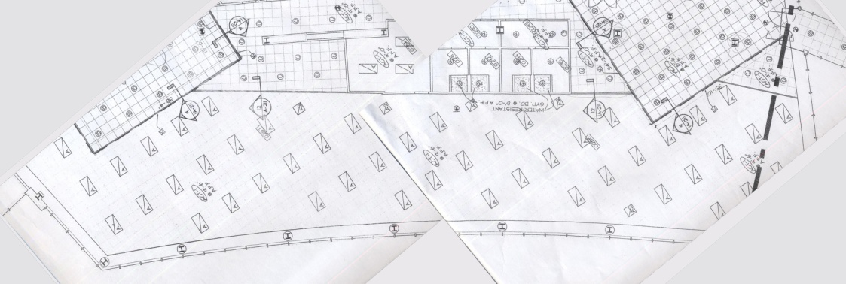
ONE CHRISTINA CRESCENT Wilmington, Delaware Lighting System Conceptual Design
OPEN OFFICE
SECOND FLOOR OPEN OFFICE REFLECTED CEILING PLAN

Slide 8
ONE CHRISTINA CRESCENT Wilmington, Delaware Lighting System Conceptual Design
OPEN OFFICE
Target Illuminance: 35-50fc (Horizontal), 5fc (Vertical)
Wall Luminance = 30 cd/m²
Light Distribution – 3:1 (ceiling:walls)
Uniform light on task plane
DESIGN ISSUES
Long hours at cubicle with intensive VDT use can lead to fatigue, feeling of isolation, eye strain
Desk lighting needs to be of an optimal level, glare-free, and most of all comfortable
There is a considerable amount of daylight entering the space. Daylight and outdoor views tend to improve mood, increase productivity, and nurture a general feeling of well-being
Nighttime provides the extremes of fatigue, depression , feelings of isolation
Intermittent conversation amongst employees can improve office morale and mood
DESIGN CRITERIA & SOLUTIONS
Provide visually stimulating areas away from the desk at the peripheries (but not distracting)
Desk lighting should be soft and smooth providing optimal task visualization without glare. Individual control of desk lighting would be ideal
Integrate and control daylight in the design in order to lower energy consumption and nurture a pleasant mood among employees
Integrate outdoor view during the night and provide artificial light that mimics day conditions
Incorporate a ‘conversation light’ between cubicle rows with a more intense desk light that focuses overall attention on work

Slide 9
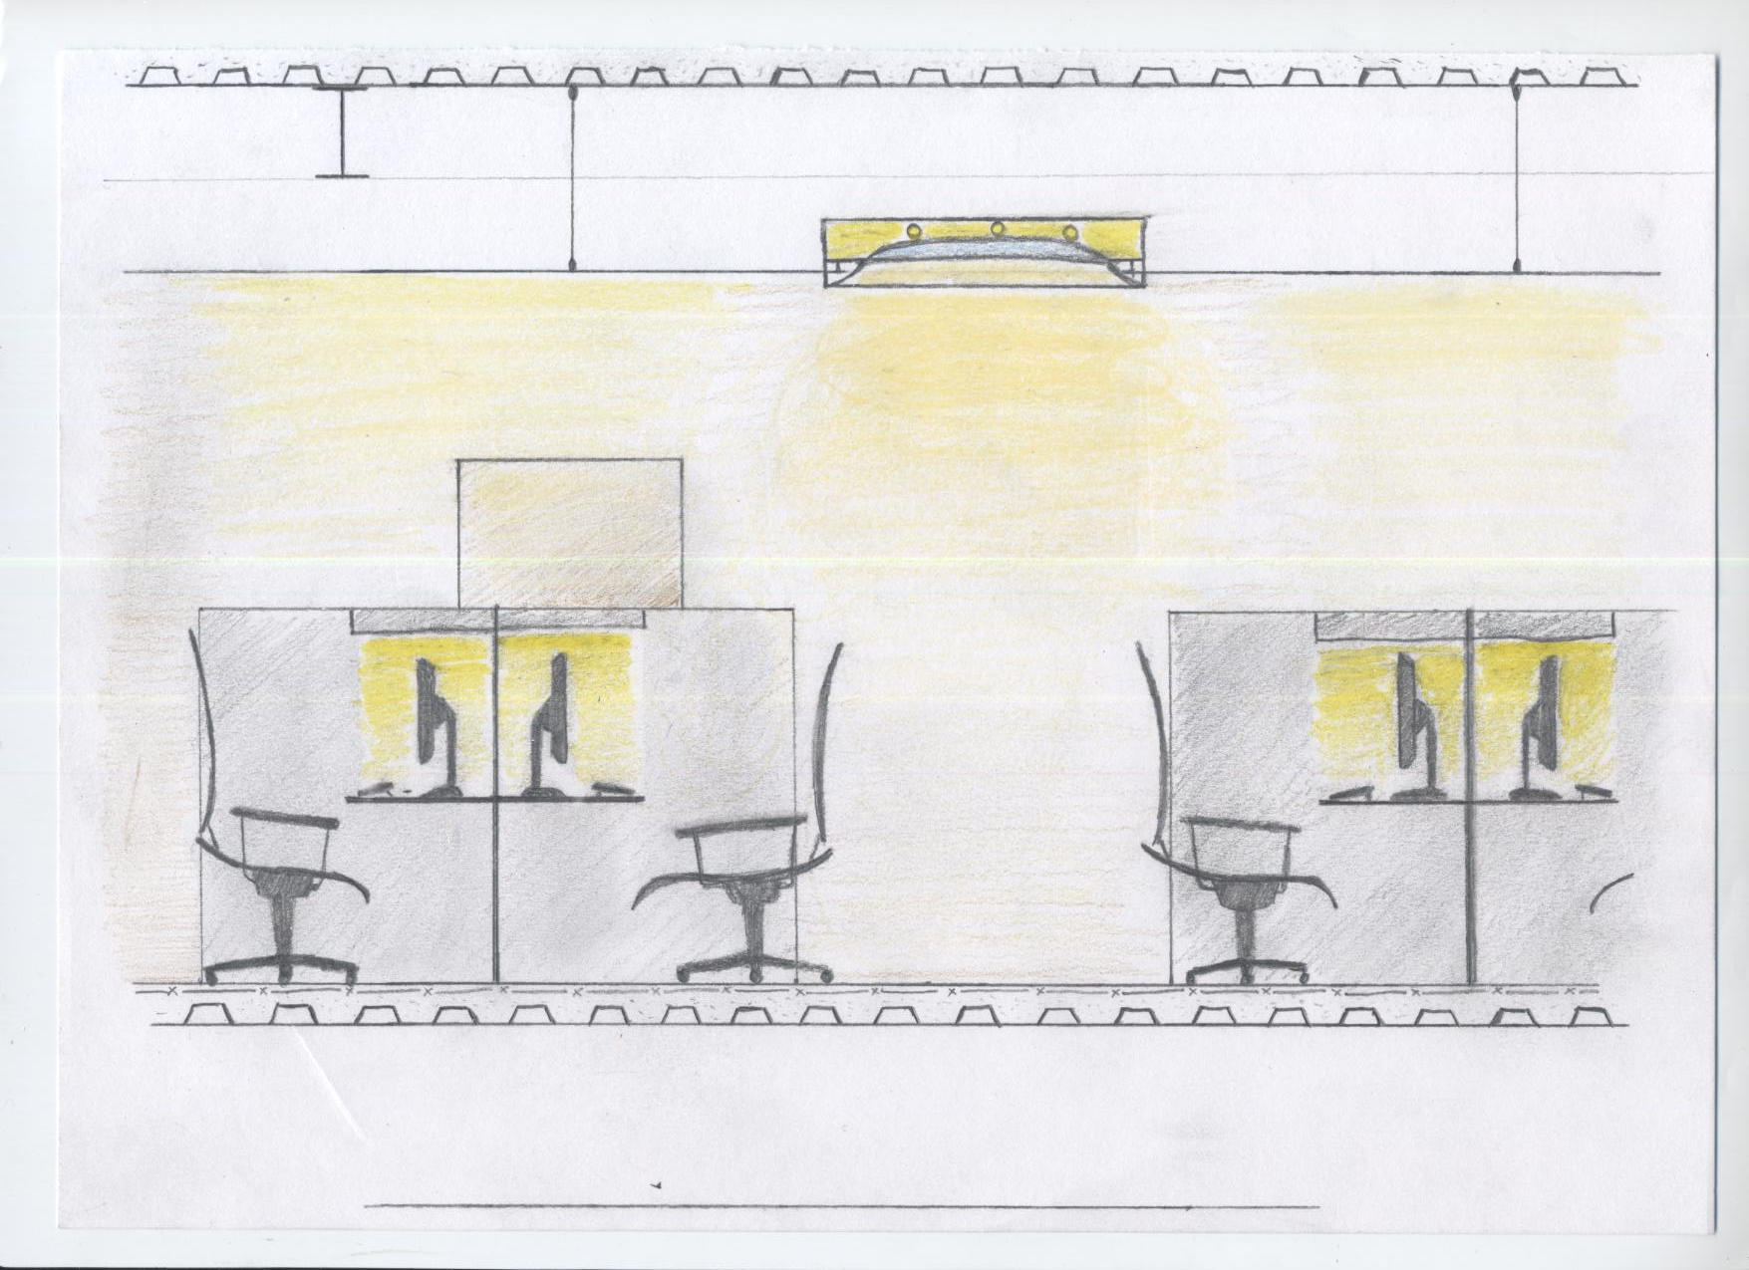
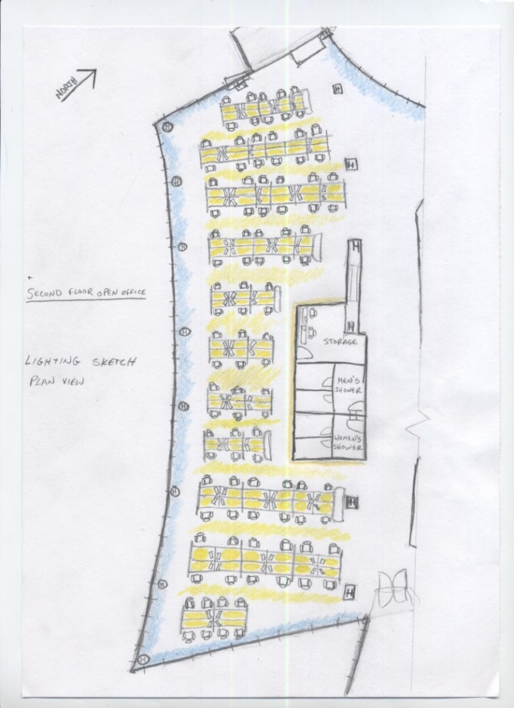
ONE CHRISTINA CRESCENT Wilmington, Delaware Lighting System Conceptual Design
OPEN OFFICE
Open Office Lighting Sketch (Plan View)
Open Office Lighting Sketch (Elevation View)

Slide 10
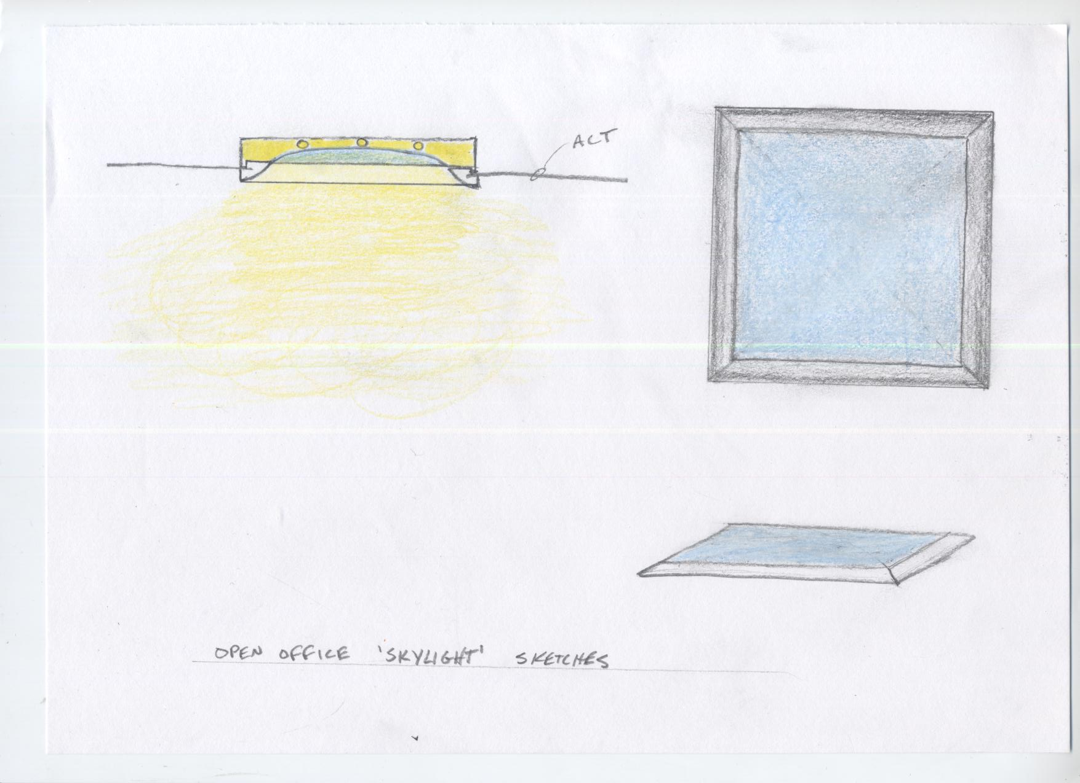
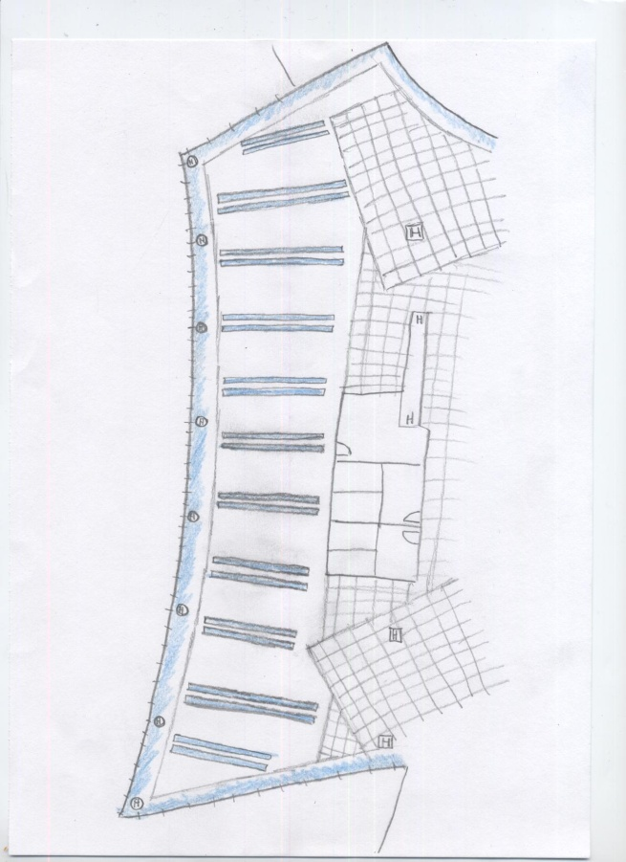
ONE CHRISTINA CRESCENT Wilmington, Delaware Lighting System Conceptual Design
OPEN OFFICE
Open Office Rectangular ‘Skylight’ Sketches
Open Office Alternate Lighting Sketch (Plan View)

Slide 11
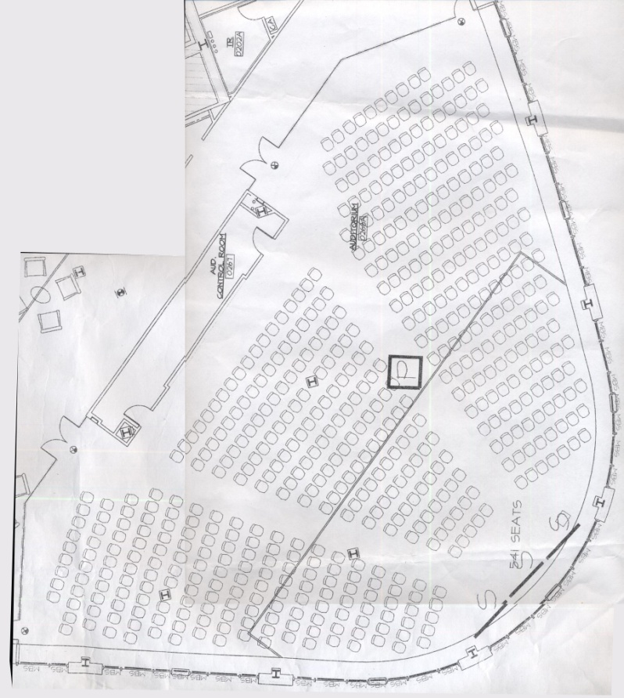
ONE CHRISTINA CRESCENT Wilmington, Delaware Lighting System Conceptual Design
AUDITORIUM
Auditorium Reflected Ceiling Plan
Auditorium Floor Plan

Slide 12
ONE CHRISTINA CRESCENT Wilmington, Delaware Lighting System Conceptual Design
AUDITORIUM
Target Illuminance: 10-30fc (Horizontal)
Control and Flexibility
Luminance of surfaces
Noise from lamps & ballasts
DESIGN ISSUES
Large room filled with many people can get warm, stuffy and uncomfortable, especially when solar gain is present
Difficulty seeing speaker and facial expressions in a large room
Audience members may be taking notes
Audience conversation should be minimal during presentation
Extended periods of time in a dense audience can foster discomfort and claustrophobic conditions. Low ceiling in a large room can exacerbate these effects.
DESIGN CRITERIA & SOLUTIONS
Reduce solar gain with shading and utilize light sources which produce minimal heat
A speaker should be accented and properly illuminated with excellent facial modeling
Provide low level ambient light for note taking
Provide low level light that is free of visual distractions. Low level of visual stimulation lighting system.
Create a pleasant and relaxing atmosphere. Illuminate ceiling surface to invoke a sense of vertical spaciousness.

Slide 13
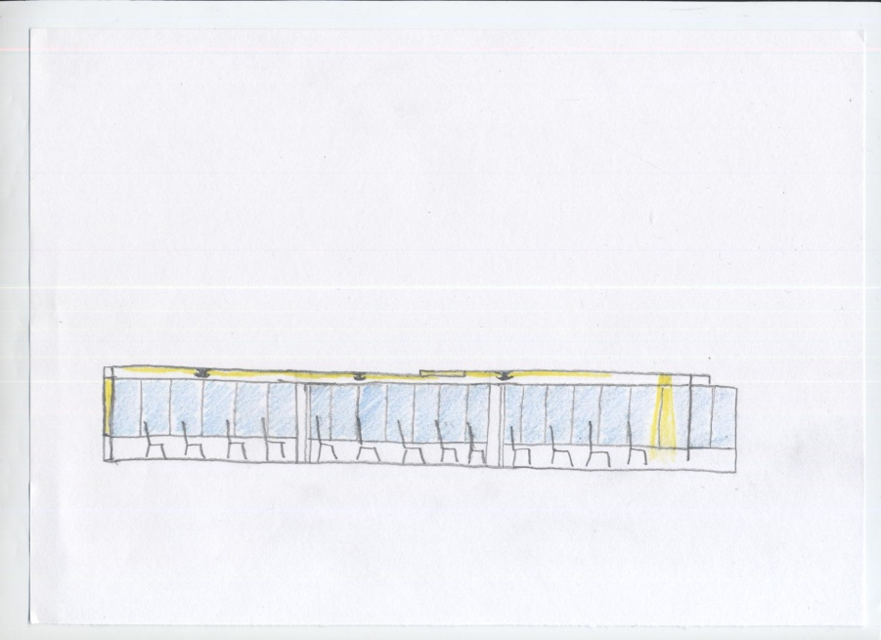
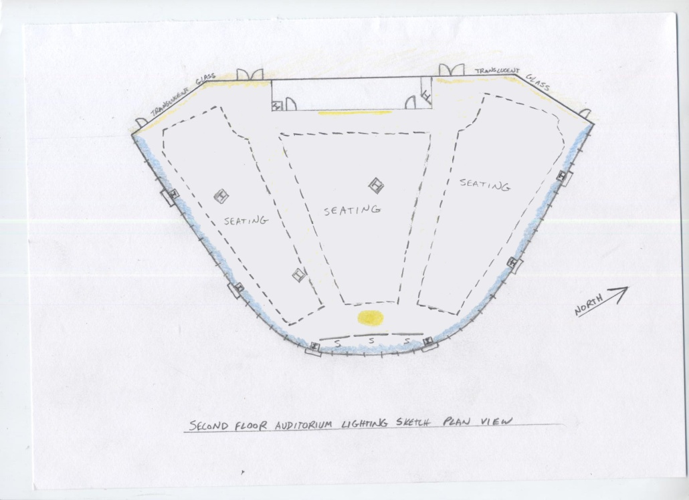
ONE CHRISTINA CRESCENT Wilmington, Delaware Lighting System Conceptual Design
AUDITORIUM
Auditorium Lighting Sketch (Elevation View)
Auditorium Lighting Sketch (Plan View)

Slide 14
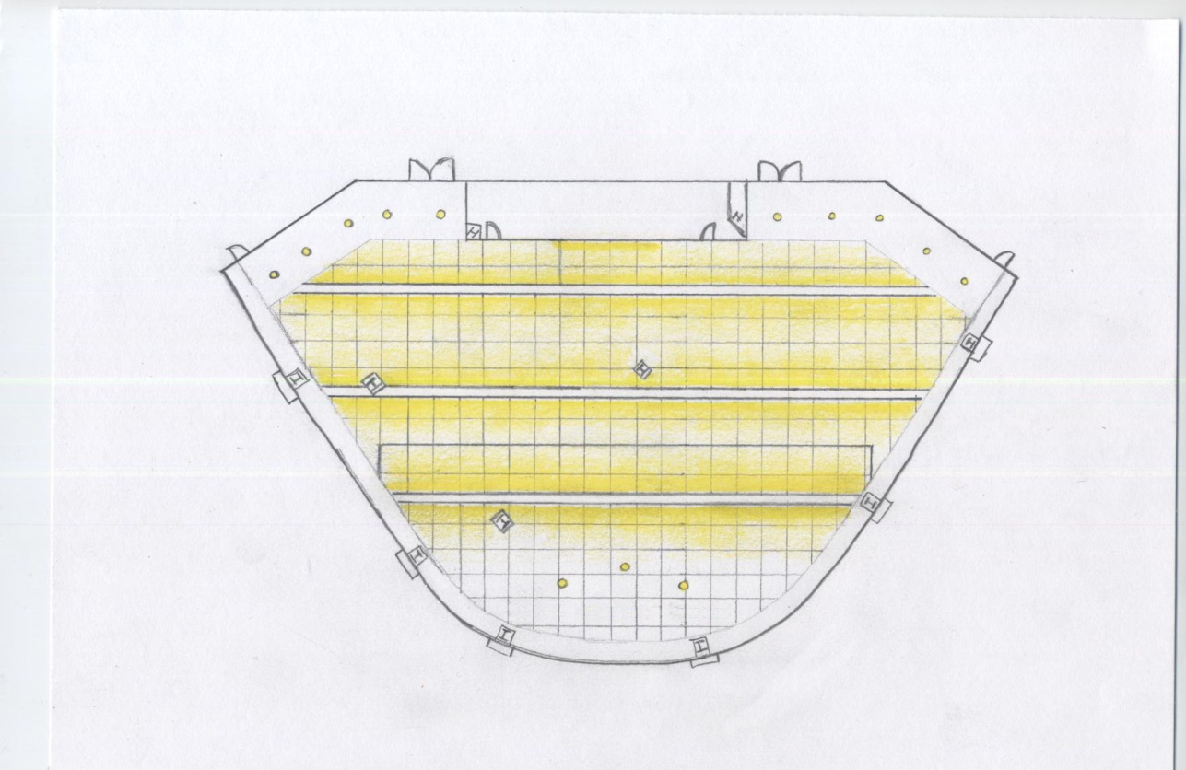
ONE CHRISTINA CRESCENT Wilmington, Delaware Lighting System Conceptual Design
AUDITORIUM
Auditorium Reflected Ceiling Plan Lighting Sketch

Slide 15
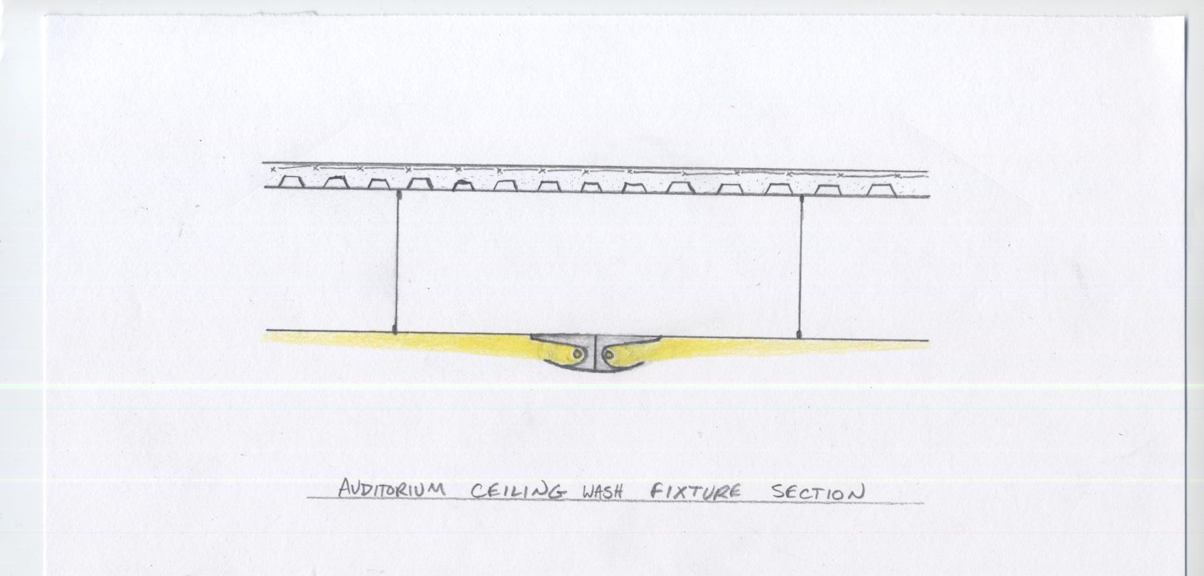
ONE CHRISTINA CRESCENT Wilmington, Delaware Lighting System Conceptual Design
AUDITORIUM
FIXTURE NOTES:
Very low ceiling profile
Far throw of uniform light
Completely concealed light source
Auditorium Ceiling Fixture (Section View)

Slide 16
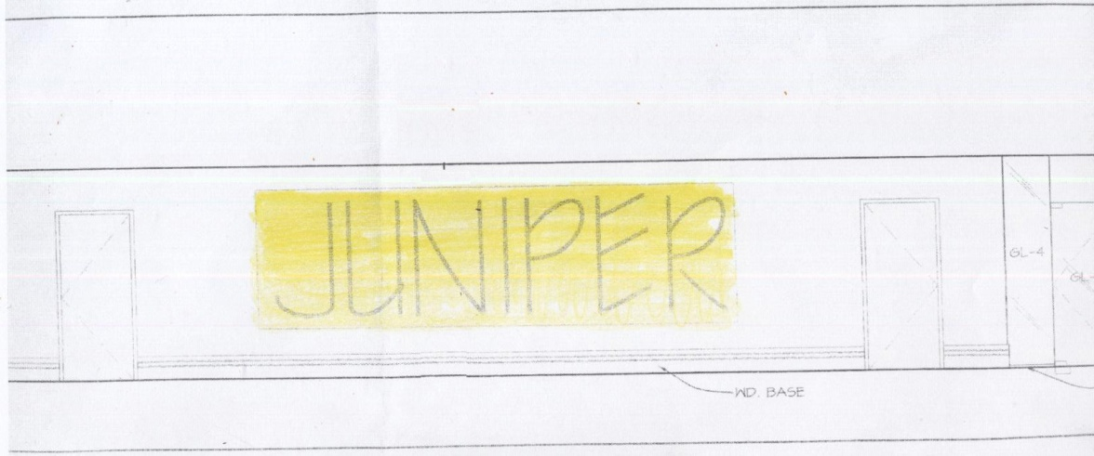
ONE CHRISTINA CRESCENT Wilmington, Delaware Lighting System Conceptual Design
AUDITORIUM
Auditorium Lighting Sketch (Elevation)
Auditorium Key

Slide 17
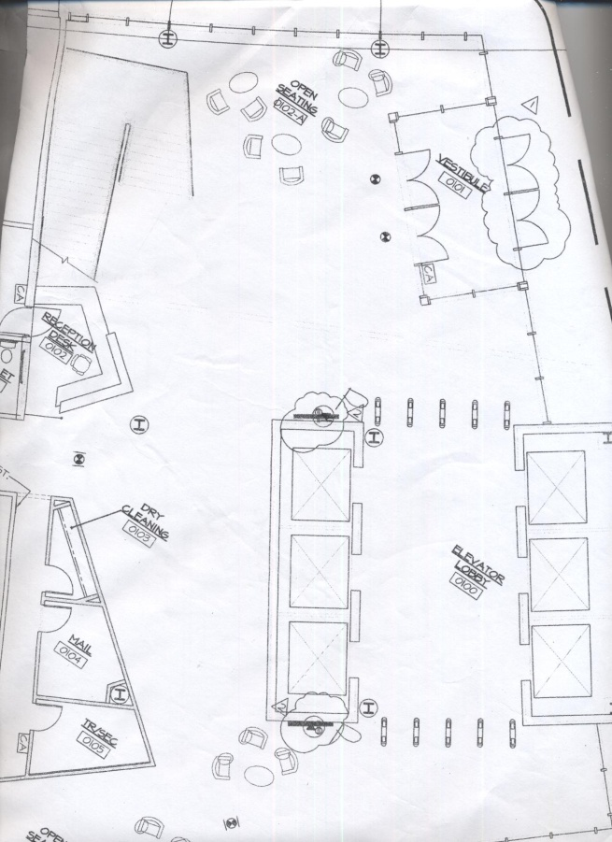
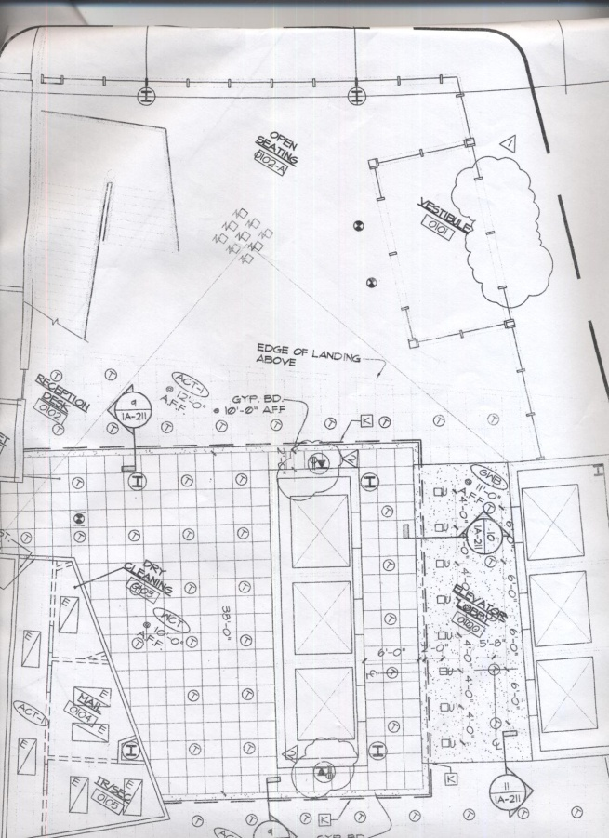
ONE CHRISTINA CRESCENT Wilmington, Delaware Lighting System Conceptual Design
LOBBY
Lobby Floor Plan
Lobby Reflected Ceiling Plan

Slide 18
ONE CHRISTINA CRESCENT Wilmington, Delaware Lighting System Conceptual Design
LOBBY
Target Illuminance: 15-25 fc (Horizontal), 3 fc (Vertical)
First Impression of Barclays
Minimize Relamping
Points of Interest
Public Space
DESIGN ISSUES
Reception desk should be visible and easy to find for visitors
Grand staircase is a prominent feature of the lobby that occupies much of the empty vertical space
Two full walls of glass up to second floor ceiling. Glass cannot be illuminated.
The lobby is two stories high with much empty vertical space
There is a large fresco on the wall adjacent to the elevator lobby
DESIGN CRITERIA & SOLUTIONS
Reception desk and corporate logo should be highlighted. Visitors eyes should be drawn to the reception desk.
Staircase as a point of interest. Proper illumination on step surfaces.
Wash interior walls with light
Incorporate decorative pendants that provide ambient light as well as ceiling illumination
Illuminate and accent the fresco as a point of interest

Slide 19
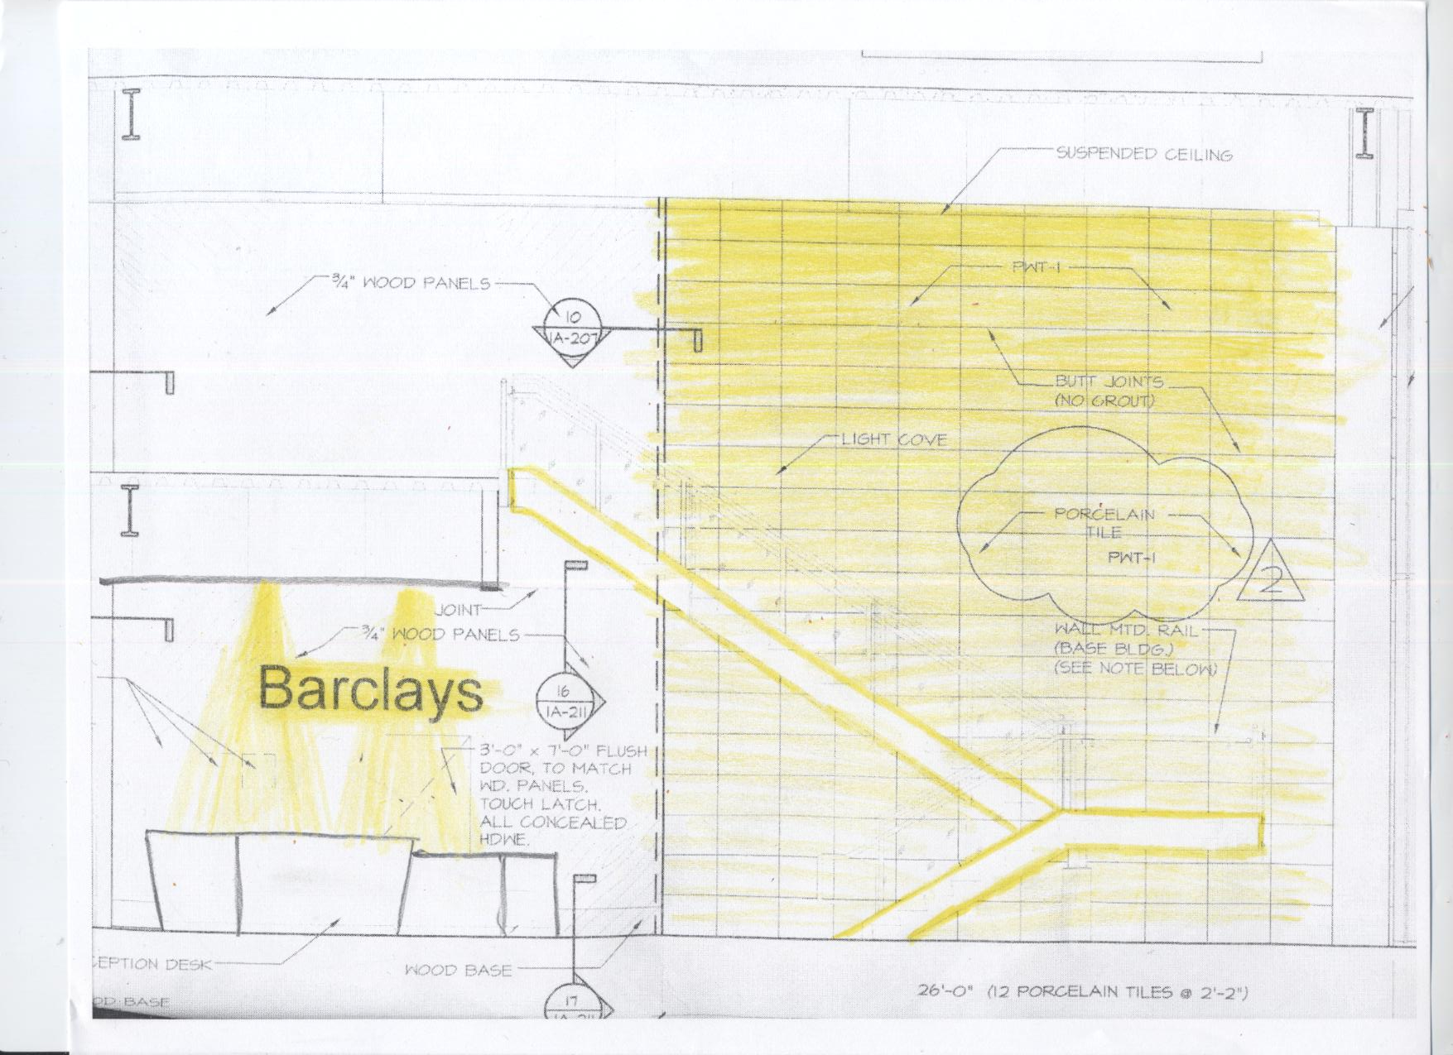
ONE CHRISTINA CRESCENT Wilmington, Delaware Lighting System Conceptual Design
LOBBY
Lobby Lighting Sketch (Plan View)
Lobby Key

Slide 20
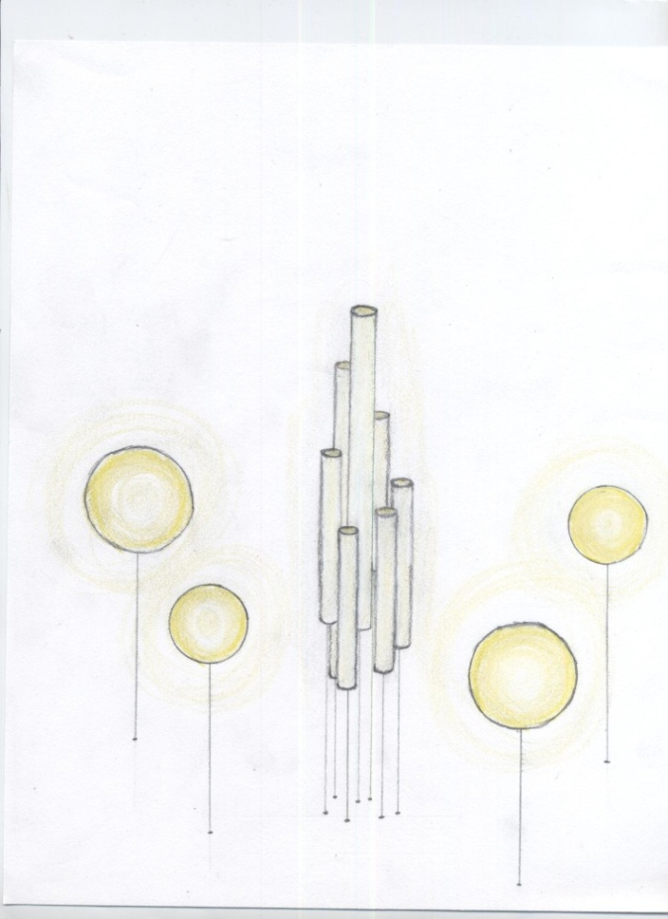
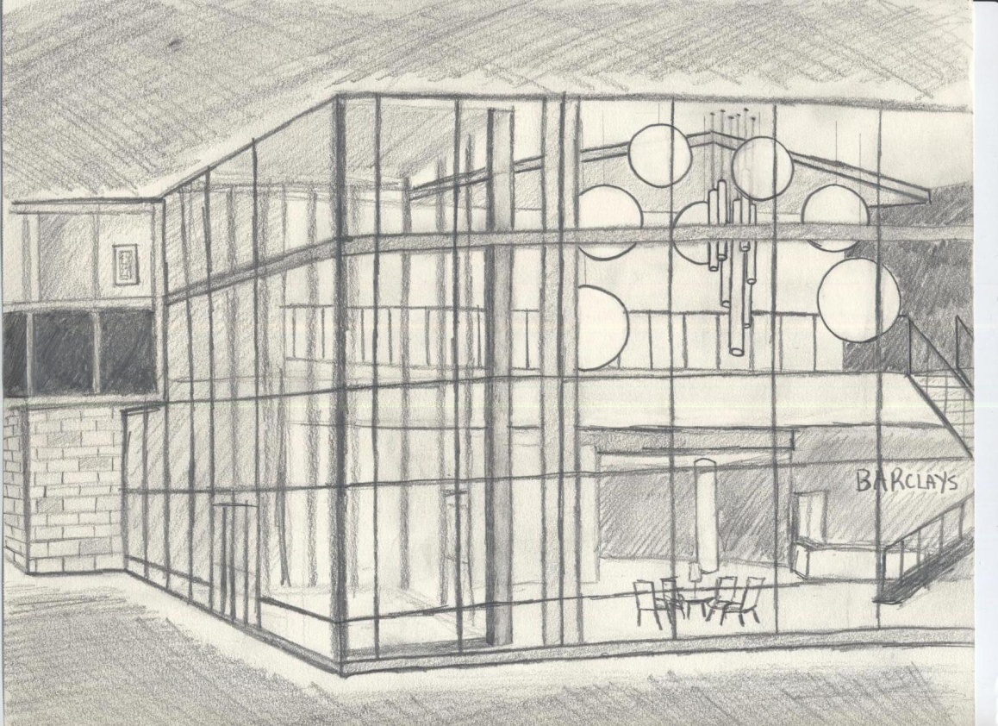
ONE CHRISTINA CRESCENT Wilmington, Delaware Lighting System Conceptual Design
LOBBY
Lobby Perspective (view from outside)
Lobby Pendant Fixtures

Slide 21
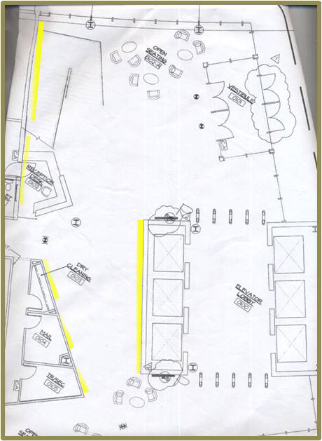
ONE CHRISTINA CRESCENT Wilmington, Delaware Lighting System Conceptual Design
LOBBY
Lobby Accent Lighting Sketch (Plan View)

Slide 22
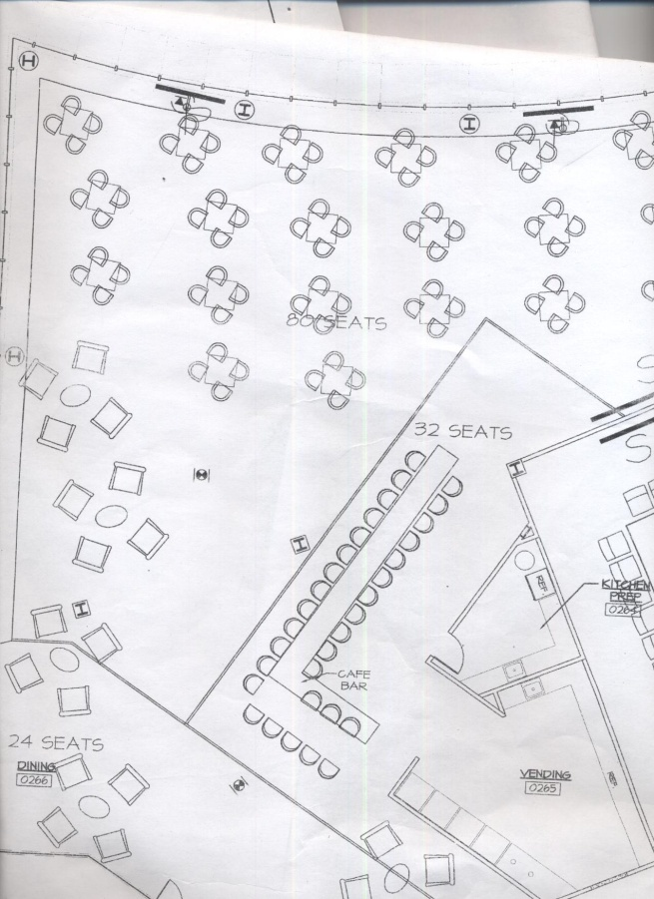
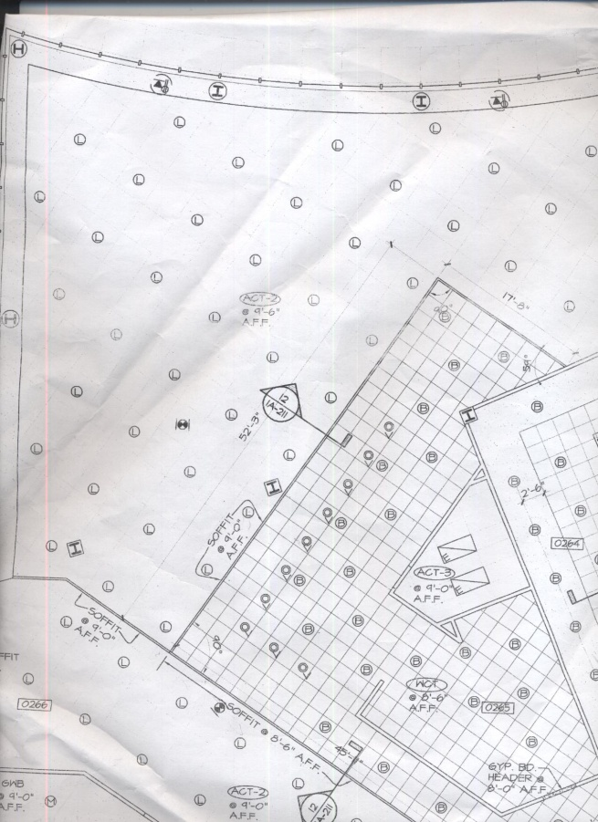
ONE CHRISTINA CRESCENT Wilmington, Delaware Lighting System Conceptual Design
DINING AREA
Dining Area Floor Plan
Dining Area Reflected Ceiling Plan

Slide 23
ONE CHRISTINA CRESCENT Wilmington, Delaware Lighting System Conceptual Design
DINING AREA
Target Illuminance: 10 fc (Horizontal), 3 fc (Vertical)
Color appearance of food
System Control/Daylighting
Points of Interest
Public Space
Minimize Relamping
DESIGN ISSUES
Dining area is unique in that activities in this space are unrelated to work
Appearance of food and facial modeling
Café Bar is a prominent and central feature of the space
Public space, but semi-private atmosphere at tables
Changing moods throughout a 24-hour period
DESIGN CRITERIA & SOLUTIONS
Distinct look from other parts of building. Provide a relaxing atmosphere. A place to socialize and re-energize.
High CRI sources for excellent rendering of food and faces. Provide a more enjoyable meal experience.
Highlight bar and use decorative fixtures in bar area
Bring light levels down at night with individual table illumination
Control system integration with a lighting system that is capable of periodic change

Slide 24
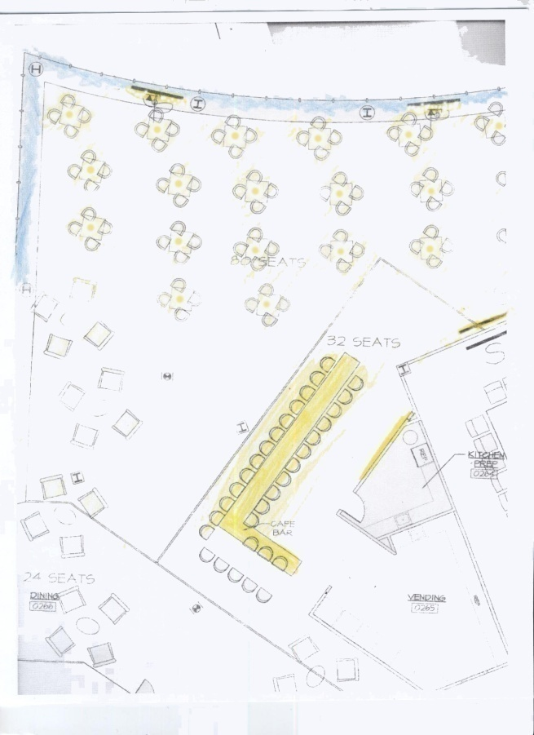
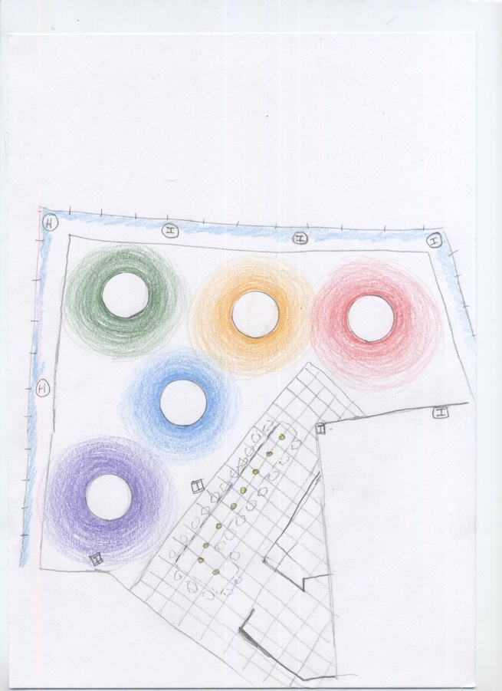
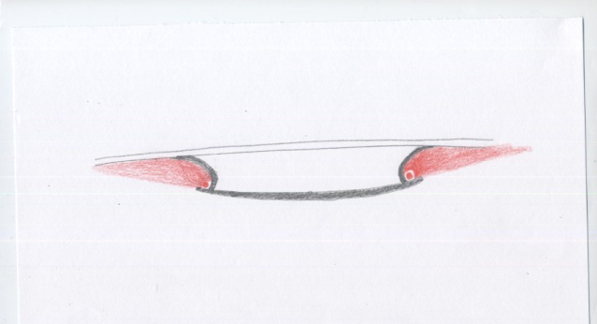
ONE CHRISTINA CRESCENT Wilmington, Delaware Lighting System Conceptual Design
DINING AREA
Ceiling Fixture Section View
Dining Area Lighting Sketch (Plan View)
Dining Area Reflected Ceiling Lighting Sketch

Slide 25
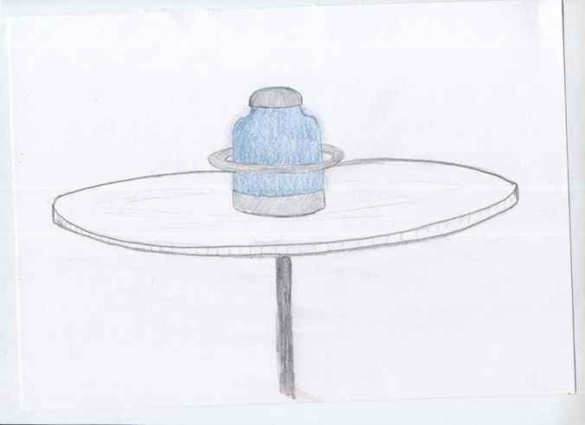
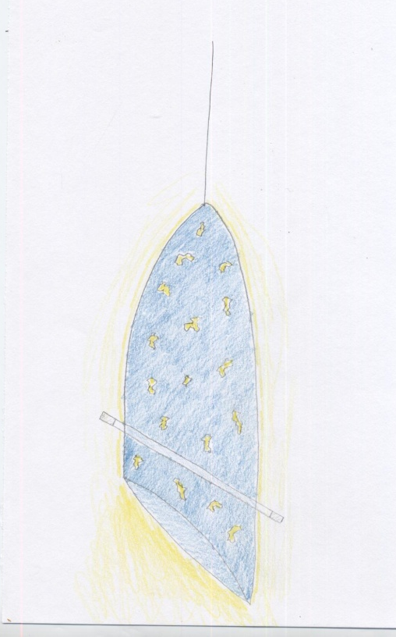
ONE CHRISTINA CRESCENT Wilmington, Delaware Lighting System Conceptual Design
DINING AREA
Café/Bar Section View
Dining Area Table Fixture
Café/Bar Decorative Pendant
Café/Bar Elevation View

Slide 26
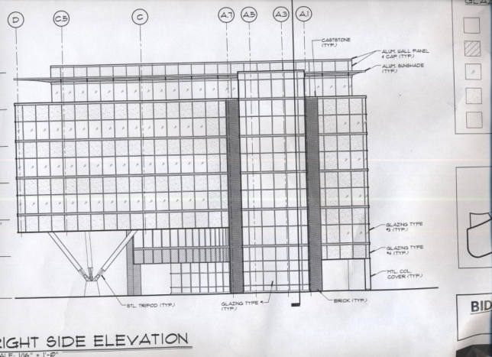
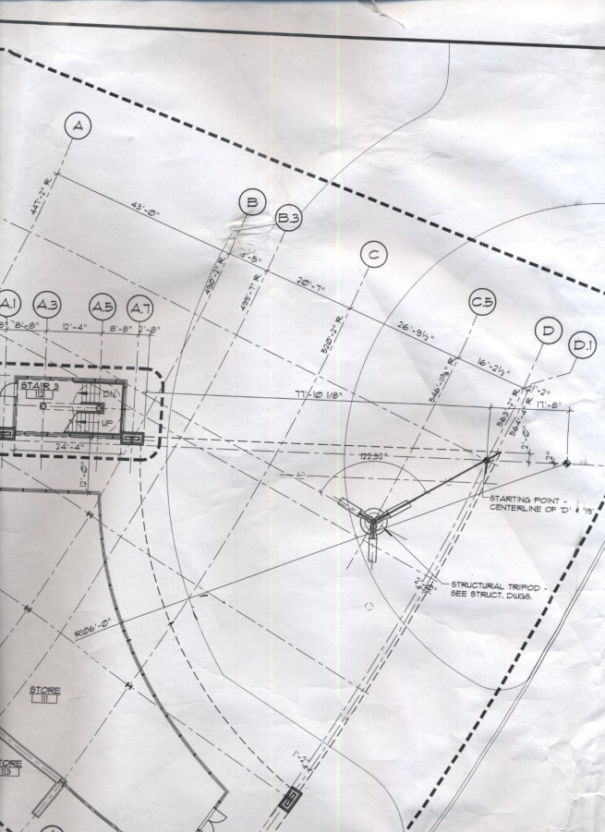
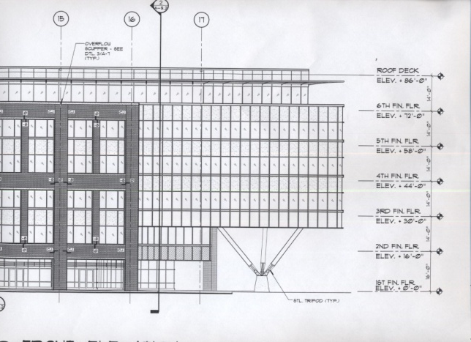
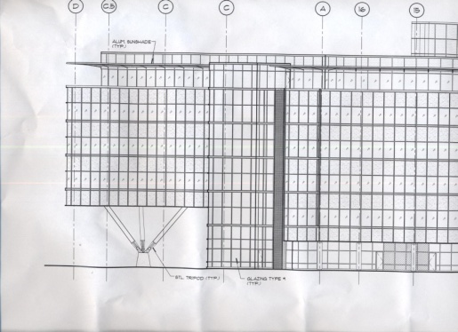
ONE CHRISTINA CRESCENT Wilmington, Delaware Lighting System Conceptual Design
TRIPOD
Tripod Area Elevation View
Tripod Area Elevation View
Tripod Area Elevation View
Tripod Area Floor Plan

Slide 27
ONE CHRISTINA CRESCENT Wilmington, Delaware Lighting System Conceptual Design
TRIPOD
Target Illuminance: 5 fc (Horizontal), 3 fc (Vertical)
Minimize light pollution
Exterior Exposure (impression of Barclays)
Points of Interest
Minimize Reflected Glare
Uniform distribution of light on traffic surfaces
DESIGN ISSUES
The structural tripod is the most prominent feature and the highlight of this outdoor space
Direct and Reflected Glare
Roadway and sidewalk illumination/light distribution
This outdoor space is highly visible from the street and surrounding areas
DESIGN CRITERIA & SOLUTIONS
Structural tripod is a point of interest but also integrated with adjacent architecture
Remove as many sources from direct sight as possible. Illuminate the underside of overhang and use it as a luminous surface
Use low profile fixtures to properly illuminate traffic areas without disturbing the architectural purity of the space
Draw attention and interest to the building and Riverfront Wilmington

Slide 28
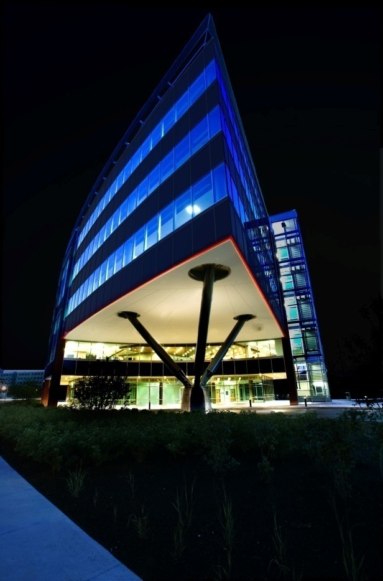
ONE CHRISTINA CRESCENT Wilmington, Delaware Lighting System Conceptual Design
TRIPOD
Low Profile Roadway Lighting Example
Tripod Photoshop Rendering

Slide 29
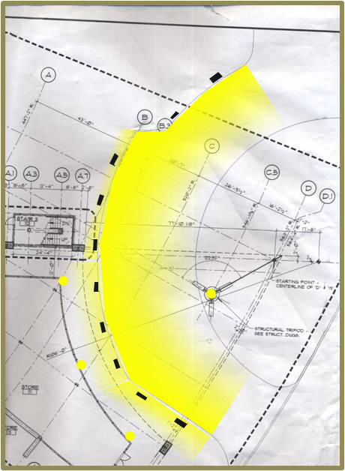
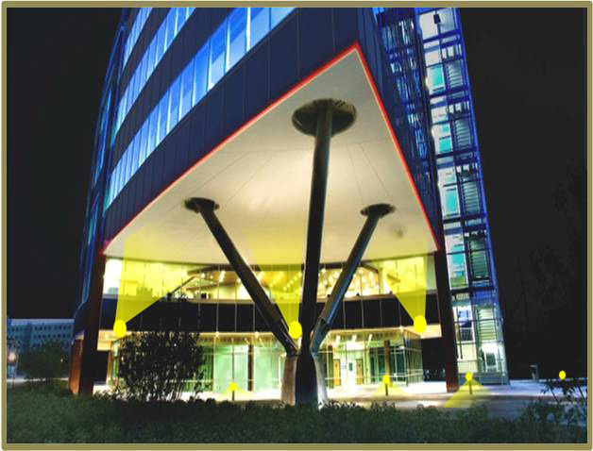
ONE CHRISTINA CRESCENT Wilmington, Delaware Lighting System Conceptual Design
TRIPOD
Tripod Spotlight & Roadway Light Positions
Tripod Lighting Sketch (Plan View)

Slide 30
ONE CHRISTINA CRESCENT
Wilmington, Delaware
Questions or Comments?
Penn State Architectural Engineering Senior Thesis

